Slide 1

Customer Segmentation with Principal Component Analysis

Slide 2
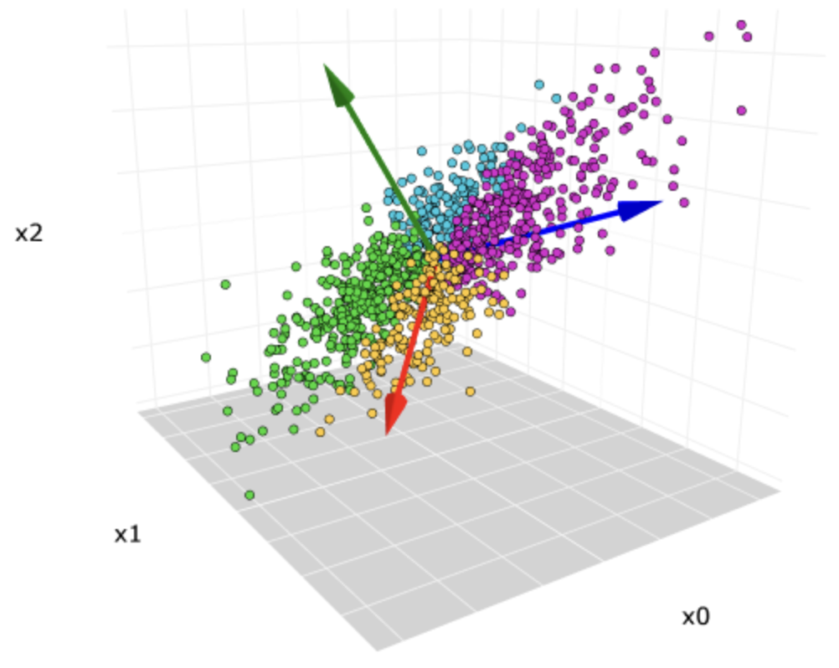
What is Principal Component Analysis(PCA)?
Principal Component Analysis (PCA) is a widely used data analysis technique that helps to identify patterns and underlying structure in high-dimensional datasets. The goal of PCA is to reduce the dimensionality of the data while retaining as much of the original information as possible.
PCA is closely related to Singular Value Decomposition (SVD), which is a matrix factorization technique that decomposes a matrix into three components: the left singular vectors, singular values, and right singular vectors. In fact, PCA can be considered as an application of SVD to the covariance matrix of the data.

Slide 3
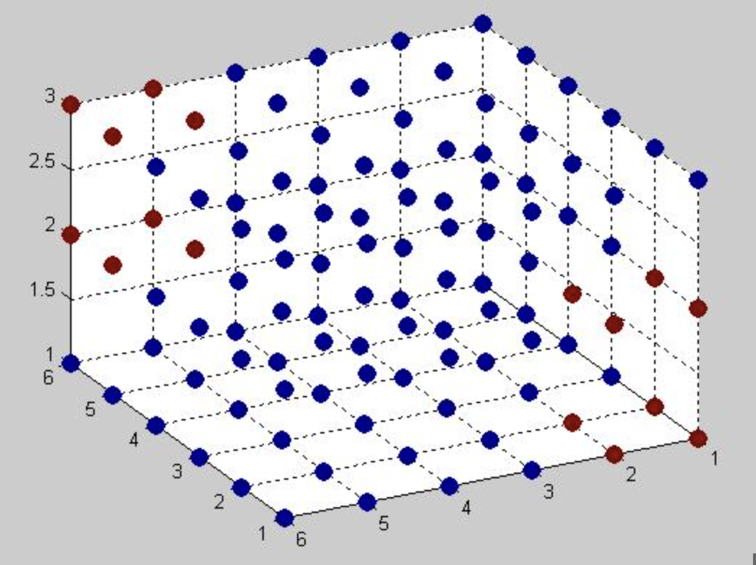
Key Concepts in PCA
Linear algebra: PCA is a technique that is rooted in linear algebra. Understanding the mathematical foundations of linear algebra is essential for understanding PCA.
Multivariate statistics: PCA is a multivariate statistical method that is used to identify patterns in high-dimensional data.
Dimensionality reduction: PCA is a method for reducing the number of dimensions in a dataset while retaining the maximum amount of information possible.

Slide 4
Key Concepts in PCA
Eigenvectors and eigenvalues: PCA involves the calculation of eigenvectors and eigenvalues of a covariance matrix.
Variance and covariance: PCA is based on the variance and covariance of the dataset.

Slide 5
Steps Involved in Computing PCA
Standardize the data: Compute mean and standard deviation for each variable, subtract the mean and divide by standard deviation to ensure that each variable is on the same scale
Compute the covariance matrix: Multiply the standardized data matrix by its transpose and divide by n-1 to get a symmetric and positive semi-definite covariance matrix.
Compute eigenvectors and eigenvalues: Find eigenvectors and eigenvalue of the covariance matrix to identify the directions of maximum variance in the data.
Sort eigenvectors by eigenvalues: Sort eigenvectors by their corresponding eigenvalues to identify the principal components that explain the most variance in the data.
Notes:
Standardize the data: This step involves computing the mean and standard deviation of each variable in the data matrix, and then subtracting the mean and dividing by the standard deviation for each value in the matrix. This centers the data around the origin and ensures that each variable is on the same scale.
Compute the covariance matrix: The covariance matrix is a measure of how the different variables in the data matrix are related to each other. It is computed by multiplying the standardized data matrix by its transpose and then dividing by the number of observations minus one. The covariance matrix is symmetric and positive semi-definite, which means that it has a set of orthogonal eigenvectors and non-negative eigenvalues.
Compute the eigenvectors and eigenvalues of the covariance matrix: The eigenvectors and eigenvalues of the covariance matrix represent the principal components of the data. The eigenvectors represent the directions of maximum variance in the data and the eigenvalues represent the amount of variance explained by each principal component.
Sort the eigenvectors by their corresponding eigenvalues: Sort the eigenvectors in decreasing order of their corresponding eigenvalues. This allows us to identify the principal components that explain the most variance in the data.

Slide 6
Steps Involved in Computing PCA
Choose number of principal components: Keep the principal components that explain most of the variance in the data.
Project data onto principal components: Project the standardized data matrix onto the chosen principal components.
Interpret the results: Analyze the loadings of each variable on the principal components to gain insights into the underlying structure of the data.
Notes:
Choose the number of principal components: Decide on the number of principal components to keep based on how much variance is explained by each component. A common rule of thumb is to keep the principal components that explain much of the total variance in the data.
Project the data onto the principal components: Project the standardized data matrix onto the chosen principal components. This results in a new matrix with fewer variables (i.e., the principal components) that captures the most important information in the original matrix.
Interpret the results: Interpret the results by analyzing the loadings (i.e., weights) of each variable on the principal components. This allows us to identify which variables contribute the most to each principal component and to gain insights into the underlying structure of the data.

Slide 7
Some Important Points
The covariance matrix summarizes the covariance relationships between all pairs of variables in a dataset.
It is a square matrix with the same number of rows and columns as the number of variables in the dataset.
The diagonal elements of the covariance matrix represent the variances of each variable, while the off-diagonal elements represent the covariances between variables.
The covariance matrix is used in Principal Component Analysis (PCA) to identify the underlying structure of the data by finding the principal components.

Slide 8
Some Important Points
PCA is a technique used to reduce the dimensionality of a dataset while retaining as much of the original variation as possible.
PCA uses the covariance matrix to calculate the eigenvectors and eigenvalues of the data.
The eigenvectors represent the principal components of the data, and the eigenvalues represent the amount of variance explained by each principal component.
The eigenvectors are sorted by their corresponding eigenvalues, and the principal components are selected based on the eigenvalues' magnitudes.
The principal components can then be used for visualization, data compression, or feature extraction.

Slide 9
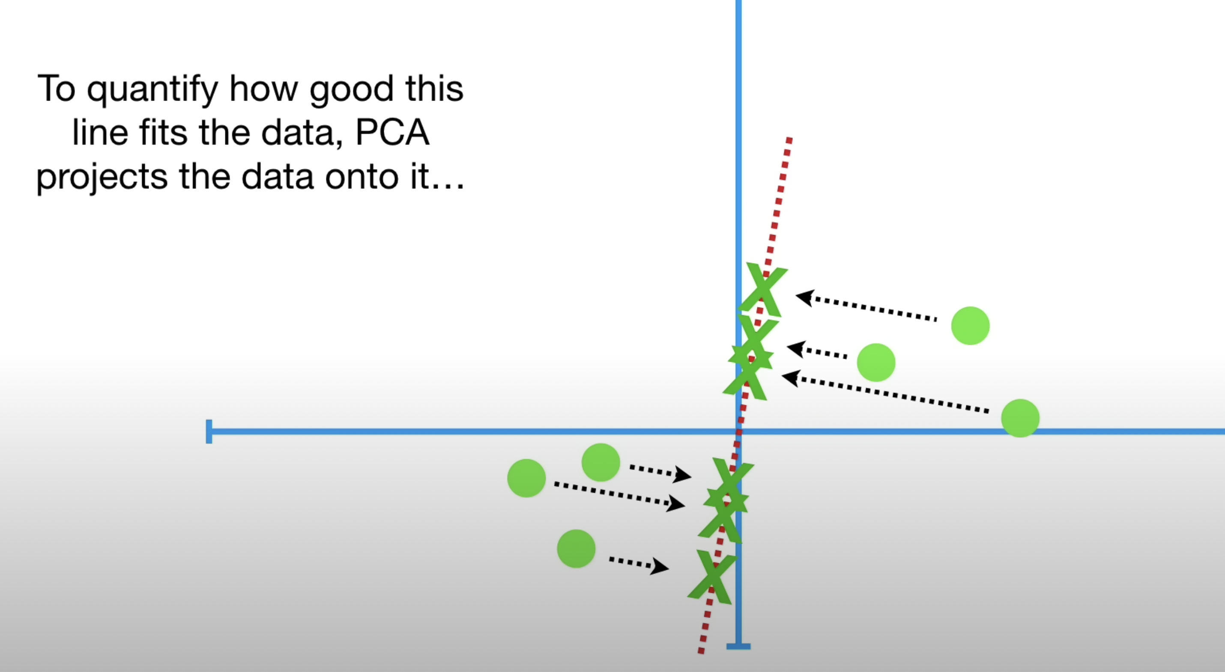
Deeper dive: Inner workings of PCA
How PCA decides if a fit is good or not?
Notes:
Let’s go back to the original line that goes through the origin. To quantify how good this line fits the data, PCA projects the data onto it. Then it can either measure the distances from the data to the line and try to find the line that minimizes those distances.
Or it can try to find the line that maximizes the distances from the projected points to the origin.

Slide 10
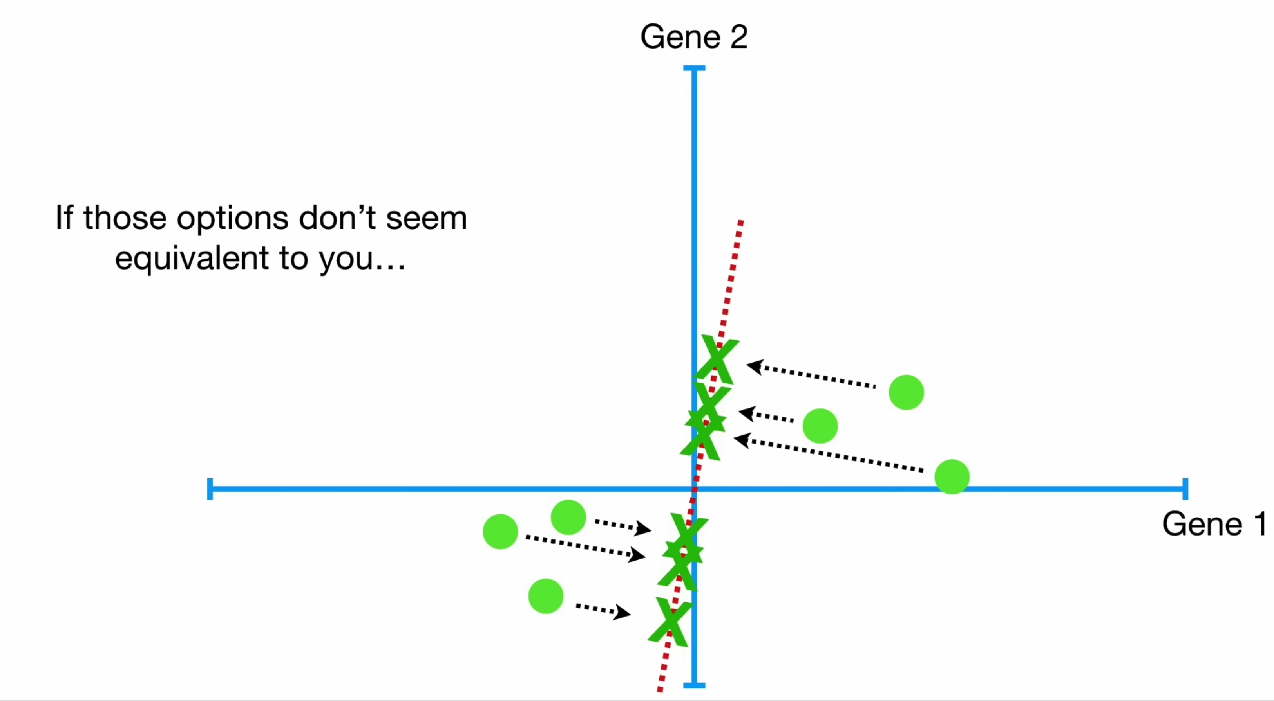
Intuition
Notes:
This may seem like a convoluted concept, so lets unpack it a little bit
We can build intuition by looking at how these distances shrink when the line fits better.

Slide 11
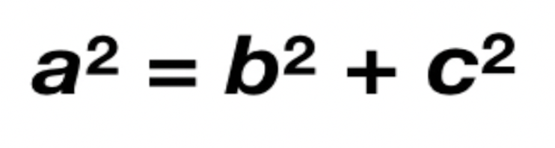
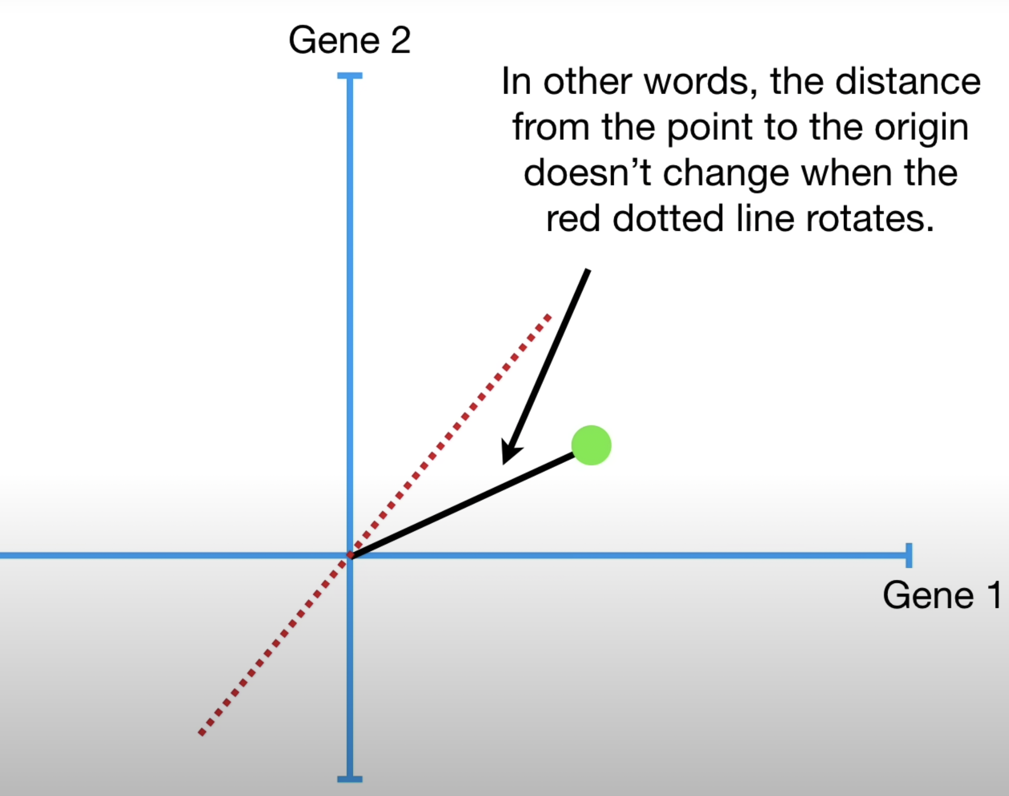
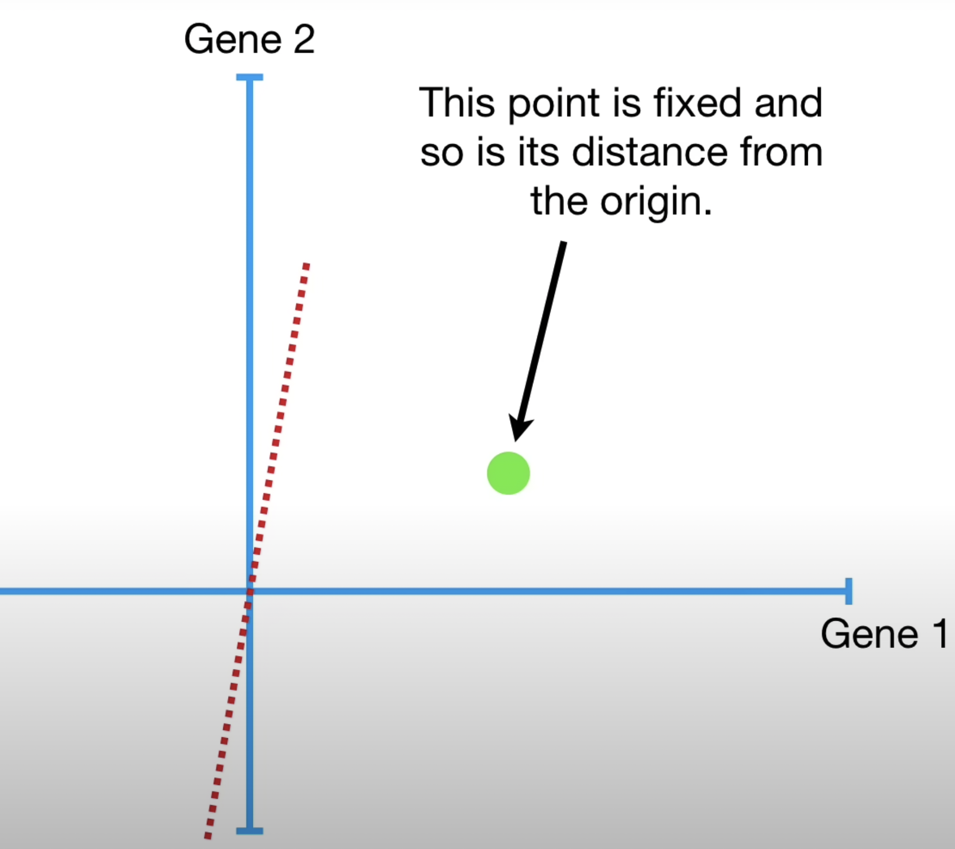
Pythagorean Theorem as player in PCA
Notes:
We are going to look at this from a mathematical concept through the lens of the Pythagorean Theorem.
Lets start with one data point
This point is fixed and so is its distance from the origin
in other words, the distance from the point to the origin doesn’t change when the red line is rotated

Slide 12
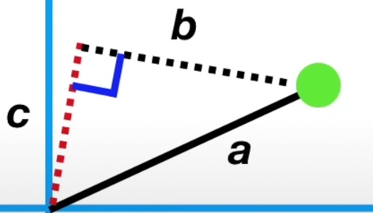
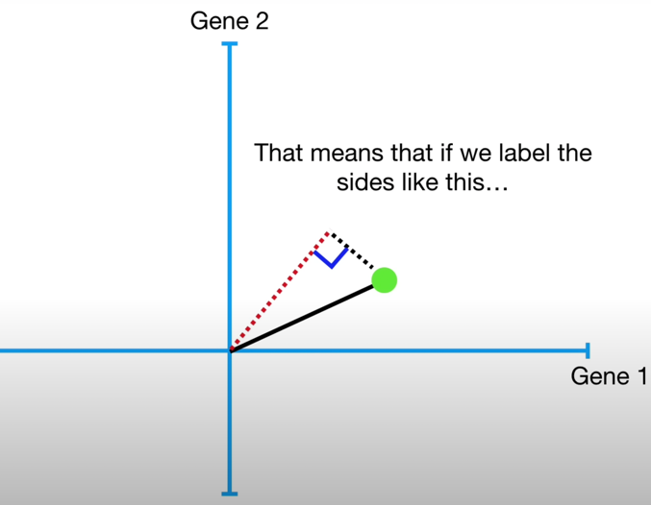
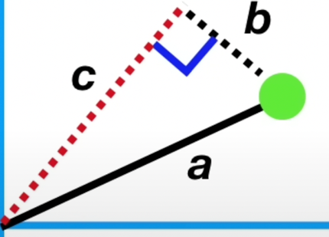
Holding ”a” stable
showing “b” and “c”s inverse relationship
Notes:
When we project the point onto the line
We get a right angle between the black line and the red dotted line. That means if we label the sides “a”, “b” and “c”, then we can use the Pythagorean Theorem to show how “b” and “c” are inversely related. Since “a” (a^2) doesn’t change.
Meaning if “b” gets bigger, then “c” must get smaller.
Likewise if “c” gets bigger, then “b” must get smaller.

Slide 13
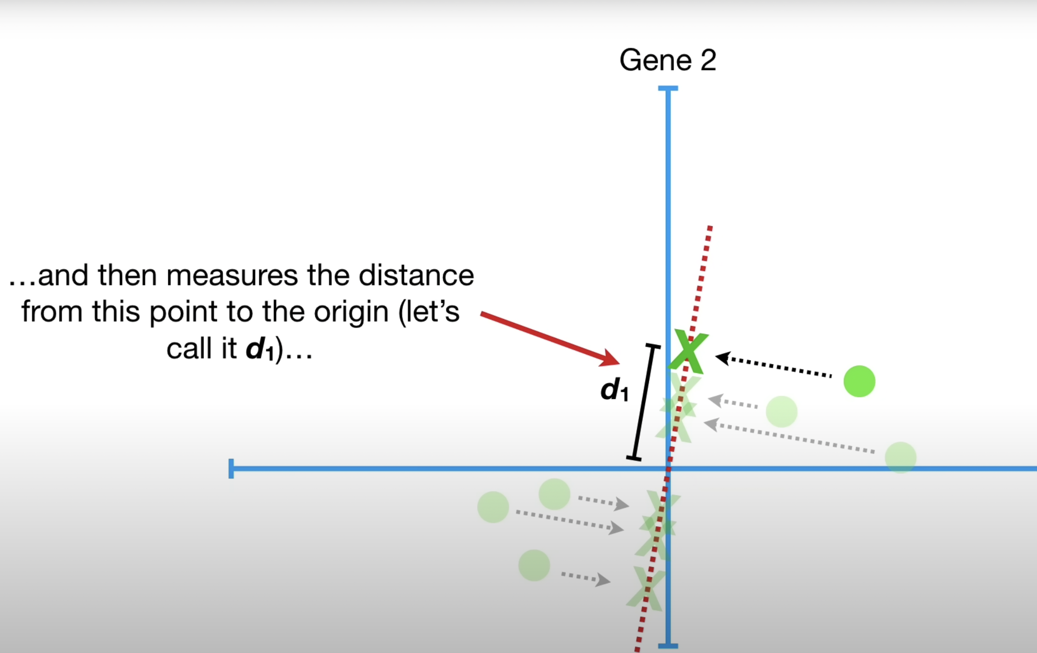
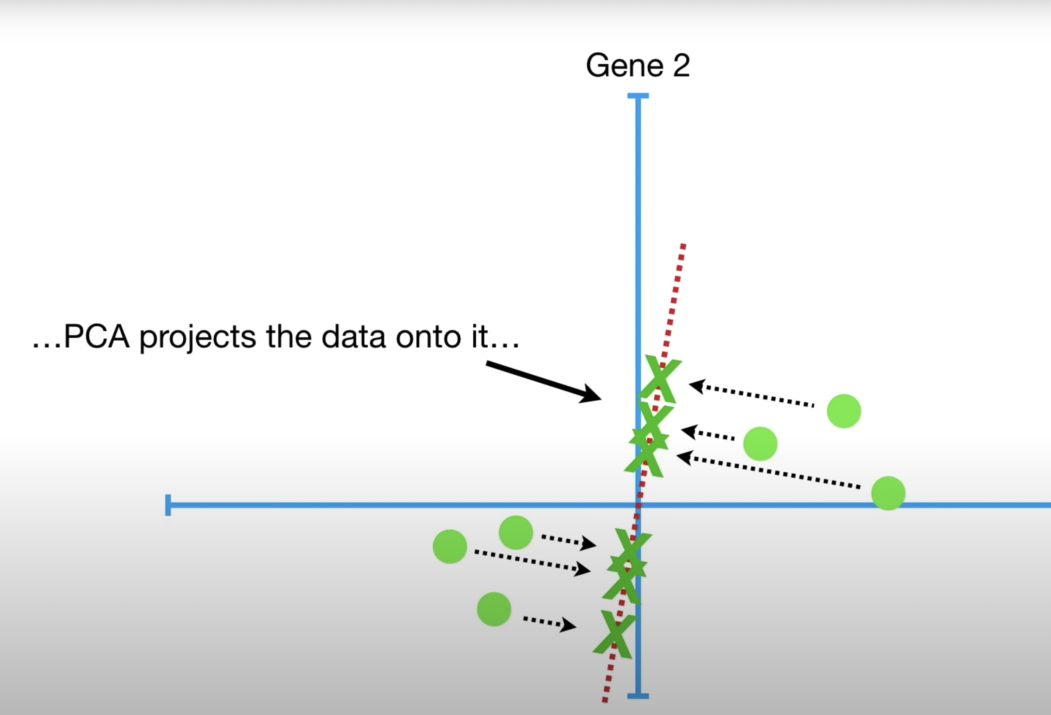
Key Takeaway
PCA can either minimize the distance to the line or maximize the distance from the projected point to the origin.
Notes:
PCA can either minimize the distance to the line or maximize the distance from the projected point to the origin.
Intuitively it would make sense to minimize “b”, and the distance from the point to the line. But (and here is where it can be confusing)
it is actually easier to calculate “c” the distance from the projected point to the origin. Therefore PCA finds the best fitting line by maximizing the sum of the squared distances from the projected points to the origin.

Slide 14
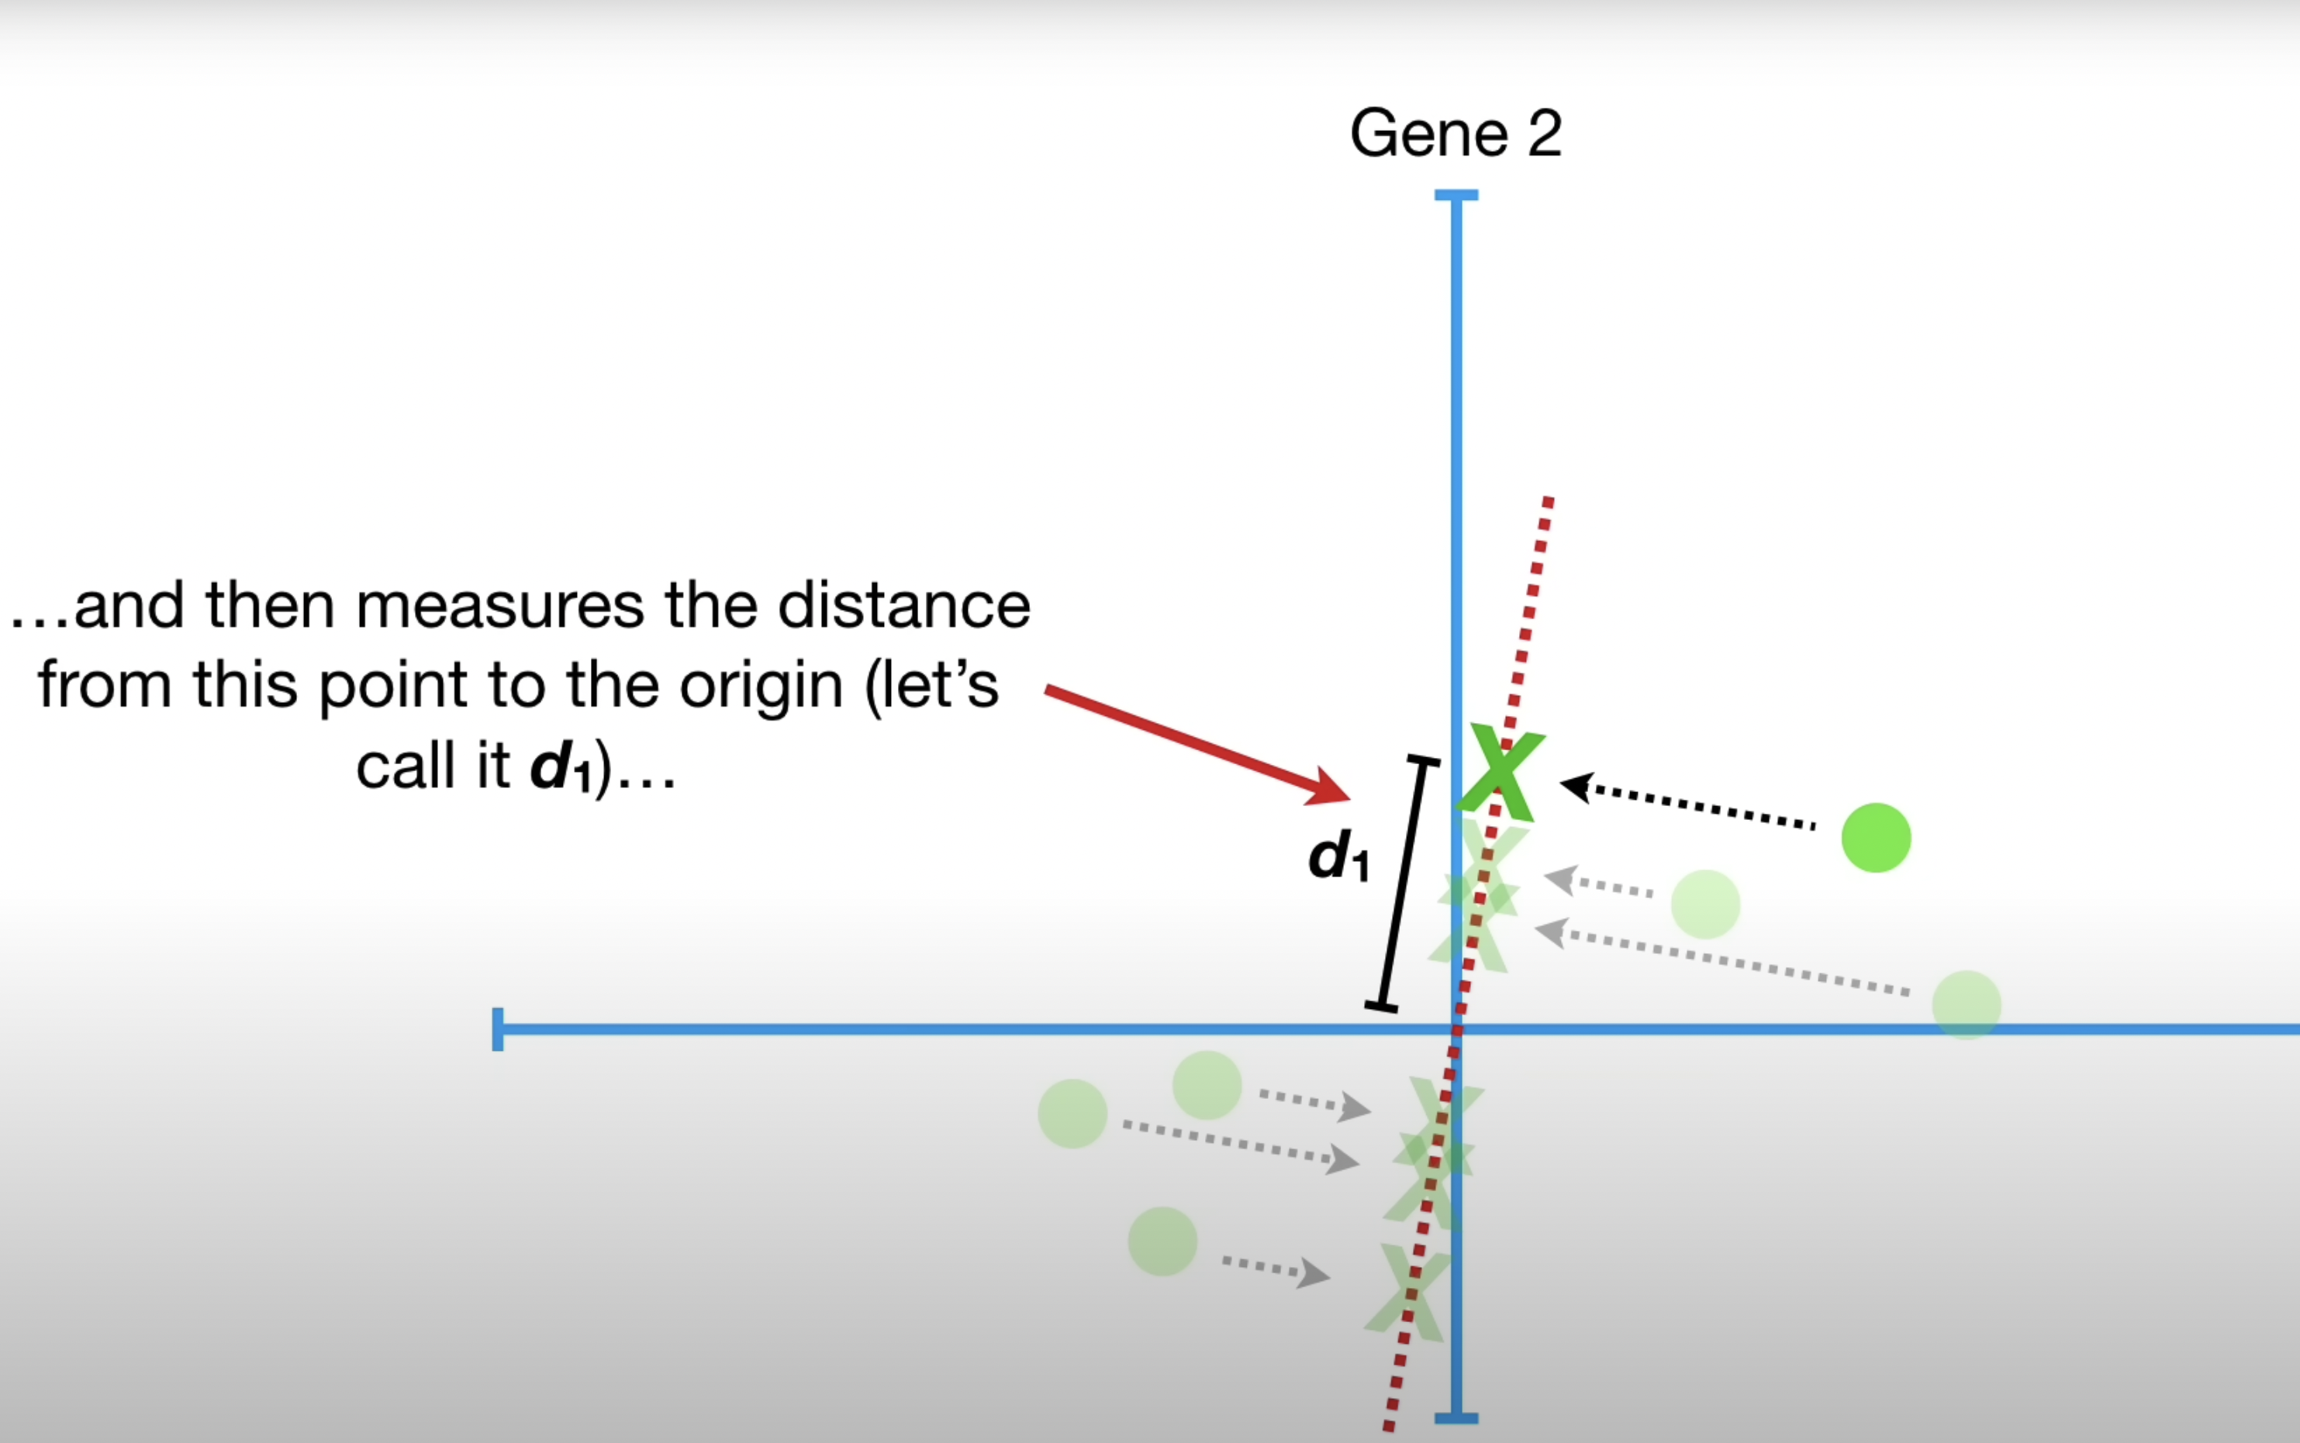
Sum of Squared Distances
Notes:
So what PCA is doing is finding the best fitting line by maximizing the total sum of squared distances from projected points to the origin
So in this example we would add up points (d1, d2…dn)
Giving us the sum of squared distances

Slide 15

Problem statement
What Use Case are we addressing?
In our case, a clothing retailer wants to segment their audience based on their purchasing behaviour. They use Black Friday Sales Data, that includes information like the amount spent on each product, frequency of buying. They also collect demographic data such as age, gender, Marital Status and location etc.
The company can use PCA to identify the key characteristics that distinguish one segment of customers from another. Keep going for the steps
Notes:
Put them in bullet points Goals(bullet points) and non goals Nobody reads a para

Slide 16
The Process
Step 1 : Define Target Audience
Step 2 : Collect data
Step 3 : Clean and pre-process the data
Step 4 : Perform PCA
Step 5 : Interpret the results
Step 6: Customer Segmentation and Product Management Suggestions
Notes:
Remove descriptions, just includes main steps, explain the steps yourself. Include all the steps in one page.
1. The clothing retailer decides to focus on customers who have made at least one purchase in the past year.
2. The company collects data on customer purchases and demographic information for this target audience.
3. The collected data is cleaned and pre-processed to remove any inconsistencies or outliers that may affect the results. 4. The pre-processed data is then fed into a PCA algorithm to identify the principal components that explain the most variance in the data.
5. The output of the PCA algorithm provides a set of principal components and their respective importance scores. The company can interpret these results to identify the key characteristics that distinguish one segment from another. For example, the first principal component may be related to the amount spent on high-end clothing, while the second principal component may be related to the frequency of purchases of accessories.

Slide 17
The Working Dataset
Customer characteristics
Gender
Age
Occupation
City
Years of stay in the Current City
Marital Status.
Derived Columns
Product_Puschase1 to Product_purchase18 : Represents time spent by the customer on each item.
Total_purchase: Total time spent by the customer
Notes:
Remove the picture snippet. \
Remove the big texts Just include the variable names to make it digestible.

Slide 18

Interpreting Results

Slide 19
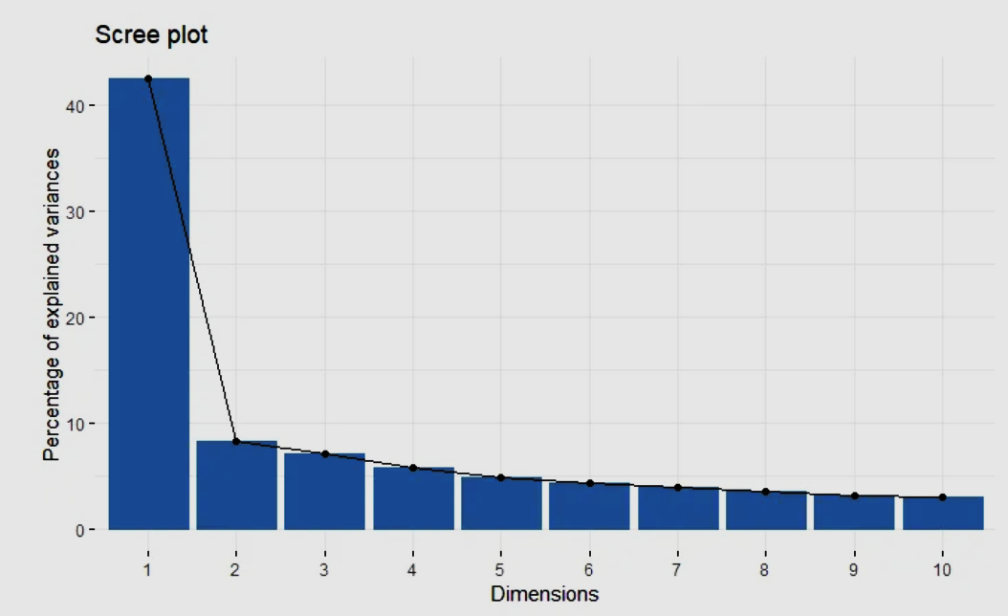
Scree Plot PC1 almost accounts for 40.3% of the variations . PC1 and PC2 together account for around 50%.
Notes:
Include a slide before this before this that says “Interpreting Results”.

Slide 20
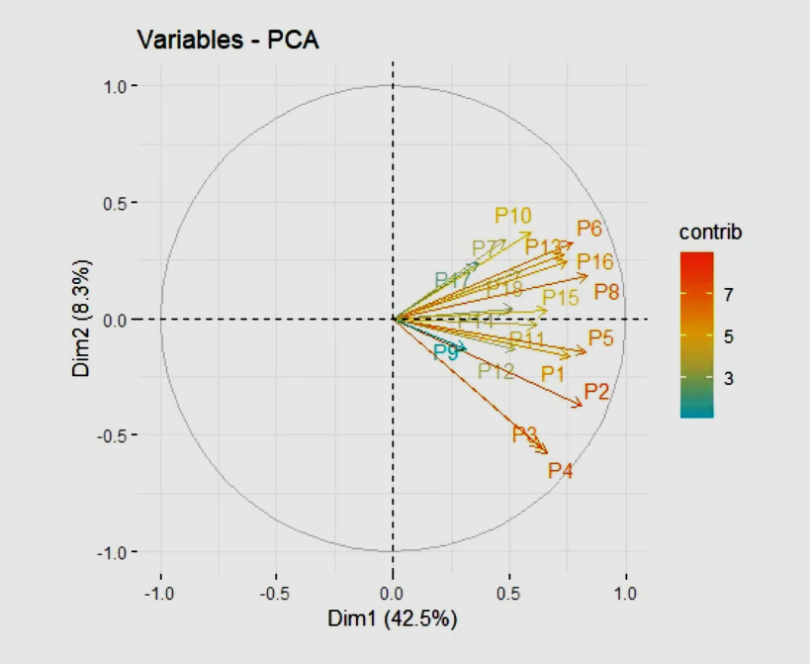
Biplot
Interpretations from the plot:
PC1 loading for every product is all positive, we can take this as an indicator that PC1 represent something similar to the “Weighted Buying Purchase Intention”, the larger the value, the higher a customer’s purchase intention.
PC2 can separate different products into different groups, the upper side has a positive PC2 value and the down side has negative PC2 value.
It is also important to notice that PC2 only contributed around 8.3% of the variation, it might suggest that our products are not quite diverse at all.
I would still like to roughly put our products into two categories:
Group1: P17,p7,p18,p10,p13,p6,p16,p8,p15
Group2: the other products
Notes:
Break down the whole para into PC1 and PC2 and just include takeaway points from the whole para.

Slide 21
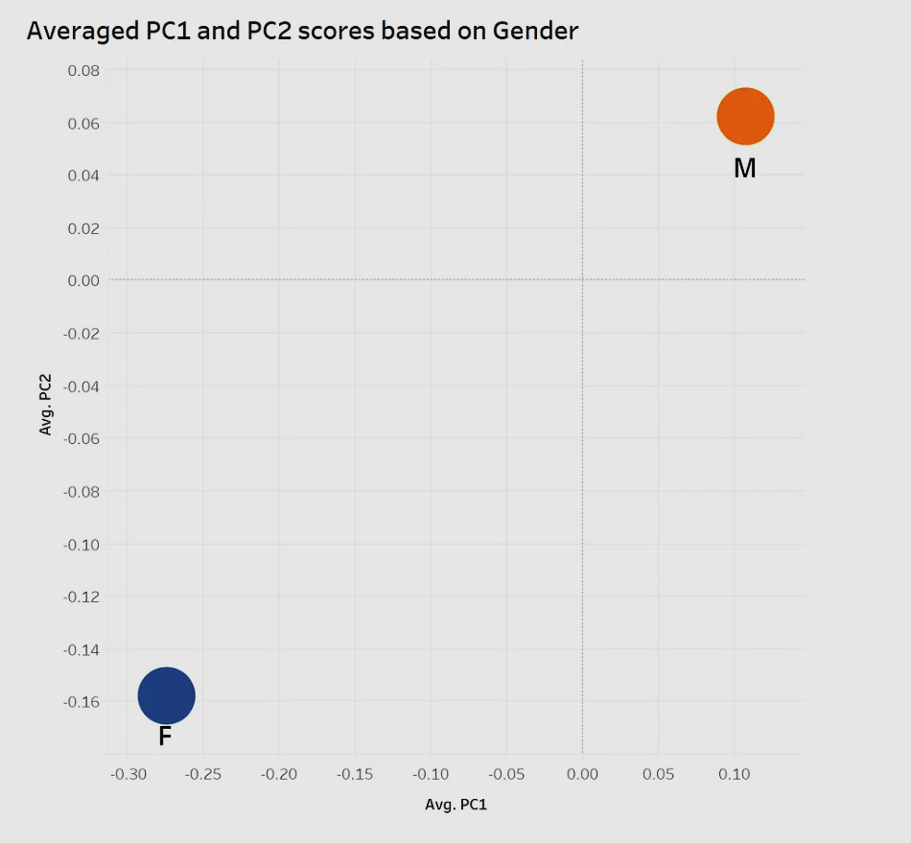
Scores based on Gender
Female has a lower purchase intention(Surprised ha?) and would like to purchase products in Group 2.
Males have a real buying intention when they visit this store and would like to purchase from Group 1.
Notes:
Remove the “opp.” about males. And say actually what that means

Slide 22
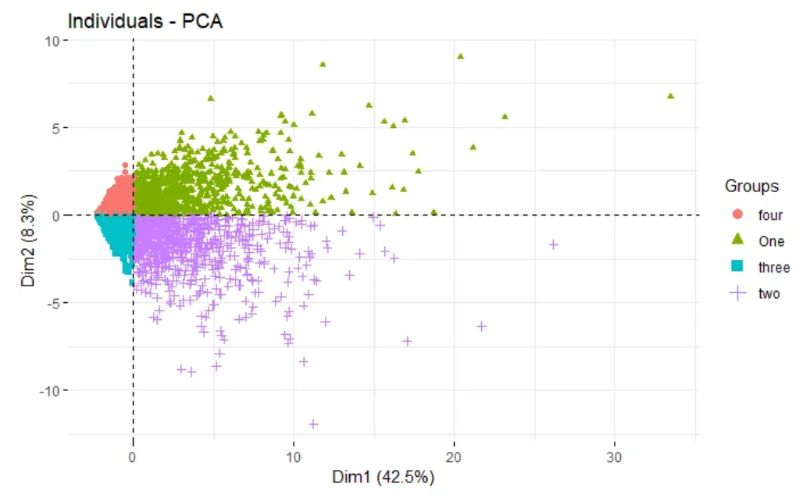
We would like to cluster our customers into different groups base on their shopping behaviours, and help us with precision marketing. The 4 broad groups in Customers is as follows: Group 1 : customers who are either age 0-17 or has occupation 17, or both. Group 2 : customers who are Occ_13 or Age 55+ Group 3 : customers who are either Occ_4 or Ages 18–25 Group 4 : the other customers
Clustering our customers
Notes:
Mention what each group reprersents over here, instead of waiting for the last slide.

Slide 23

Customer Segmentation and Product Management Suggestions

Slide 24
1. Product Groups
Group 1: P17,p7,p18,p10,p13,p6,p16,p8,p15
Group 2: the other products
2. Customer Segments
Do precision marketing and product recommendation base on our customer segmentation
Group One: customers who are either ages 0-17 or has occupation 17, or both.
Group Two: customers who are Occ_13 or Age 55+
Group Three: customers who are either Occ_4 or Age 18–25
Group four: the other customers
3. We can use PC1 score that we described above as an indicator of customer purchase intention
Notes:
Include a previous slide that says Step 6 and the name. Use inverted colors for main intro slide for each part.

Slide 25
Future Work for Data Team

Slide 26
Potential Improvements
1. Customer Purchase Info
i. What are the prices of each product?
ii. What are the number of items bought in each purchase?
iii. What are the cost/revenue of each product?
iv. Purchased time point for analysing and arranging rush hours
2. Additional Customer Characteristics
More customer characteristic can be collected to better segment our customers into groups
Notes:
Condense them into customer and purchase characteristics.

Slide 27
The End

